Slide 1
Machine Learning - Introduction
Training, Loss and Gradient Descent

Slide 2


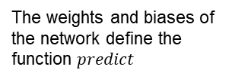
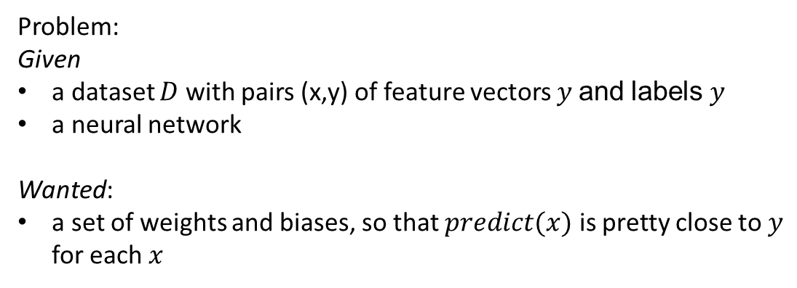
We see a Neural Network as a Black Box transforming feature vectors into labels.
Neural
Network
(„predict“)
$$x$$
$$predict(x)$$
The weights and biases of the network define the function $predict$
Problem:
Given
a dataset $D$ with pairs (x,y) of feature vectors $y$and labels$y$
a neural network
Wanted:
a set of weights and biases, so that $predict(x)$ is pretty close to $y$ for each $x$

Slide 3

Loss (MSE)
$$MSE=\frac{1}{N} \sum_{\left(x,y\right)∈D }{{\left(y −predict\left(x\right)\right)}^{2}}$$
Note
MSE is very often used in ML
There are other loss concepts, that might work better specific problems

Slide 4
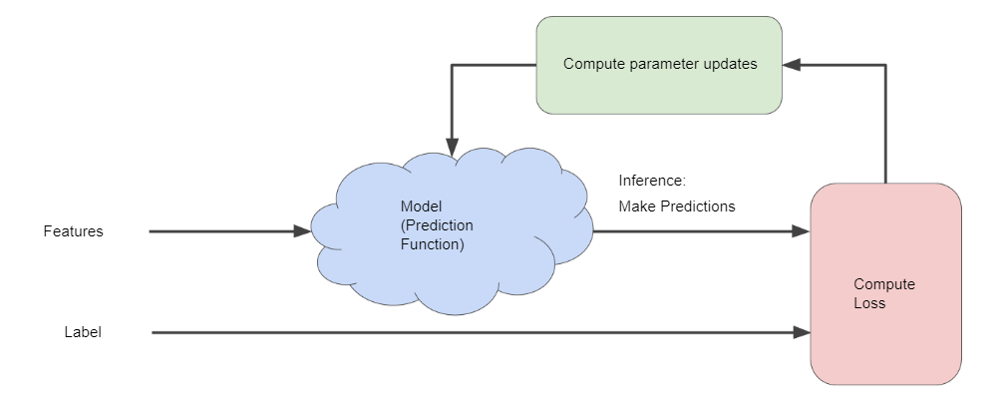
Reducing Loss

Slide 5
Reducing Loss

Slide 6

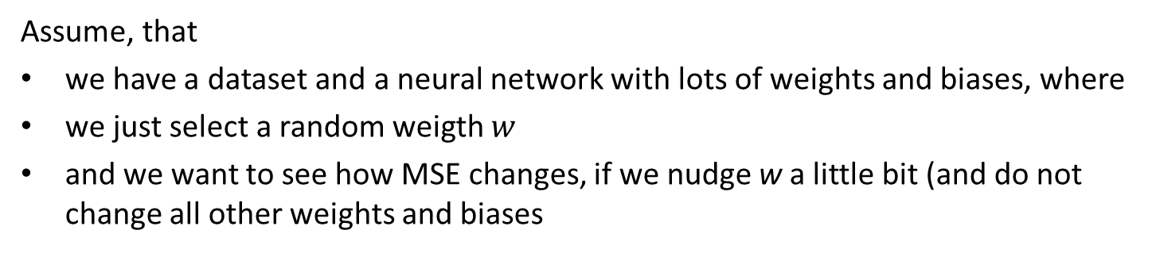

Experiment
Assume, that
we have a dataset and a neural network with lots of weights and biases, where
we just select a random weigth $w$
and we want to see how MSE changes, if we nudge w a little bit (and do not change all other weights and biases
starting point
„descent step“
next point
Loss(w)
(MSE depending on w)
$$w_{}^{(0)}$$
$$w_{}^{(1)}$$
w

Slide 7

How can we calculate the next point?
Assume, that our Loss-function is differentiable, then
$$Loss^{′}\left(w\right)= \lim_{h →0 }{\frac{Loss\left(w+h\right)−Loss(w)}{h}}$$
So for sufficiently small h we get
$$Loss\left(w+h\right)≈Loss\left(w\right)+Loss^{′}\left(w\right)⋅h$$
If we select $h$ with
$$Loss^{′}\left(w\right)⋅h <0$$
and hence
$$Loss\left(w+h\right)< Loss\left(w\right)$$

Slide 8
Gradient Descent and Learning Rate („step size“)
The iterative method to approach to a minimum from a given starting point is called gradient descent.
If we use the same absolute value for $h$ in each step, then we call this value the learning rate

Slide 9
Excercise
https://developers.google.com/machine-learning/crash-course/fitter/graph

Slide 10
Batches
In gradient descent, a batch is the total number of examples you use to calculate the gradient in a single iteration. So far, we've assumed that the batch has been the entire data set. When working at Google scale, data sets often contain billions or even hundreds of billions of examples. Furthermore, Google data sets often contain huge numbers of features. Consequently, a batch can be enormous. A very large batch may cause even a single iteration to take a very long time to compute.
A large data set with randomly sampled examples probably contains redundant data. In fact, redundancy becomes more likely as the batch size grows. Some redundancy can be useful to smooth out noisy gradients, but enormous batches tend not to carry much more predictive value than large batches.
What if we could get the right gradient on average for much less computation? By choosing examples at random from our data set, we could estimate (albeit, noisily) a big average from a much smaller one. Stochastic gradient descent (SGD) takes this idea to the extreme--it uses only a single example (a batch size of 1) per iteration. Given enough iterations, SGD works but is very noisy. The term "stochastic" indicates that the one example comprising each batch is chosen at random.
Mini-batch stochastic gradient descent (mini-batch SGD) is a compromise between full-batch iteration and SGD. A mini-batch is typically between 10 and 1,000 examples, chosen at random. Mini-batch SGD reduces the amount of noise in SGD but is still more efficient than full-batch.
To simplify the explanation, we focused on gradient descent for a single feature. Rest assured that gradient descent also works on feature sets that contain multiple features.
https://developers.google.com/machine-learning/crash-course/reducing-loss/stochastic-gradient-descent

